Slide 1


Unsupervised Multimodal Matching
in social media posts
Coco Diru GQ Jiang Kyle Wenqi
Date: 11/12/2021
Notes:
Hi everyone This is Team 5. We have Coco Diru Jiang Kyle and I’m GQ. Our teammate Wenqi has hurt his hand, so unfortunately, he can’t be with us today.
So today we gonna introduce our project with MVP. Our project is called Unsupervised Multimodal Matching in social media posts. It’s obvious that we use unsupervised methods to match similar posts based on multimodal information. aka SEARCH BY POSTS.
So firstly, what are we doing?

Slide 2




WHY?
Unsupervised
Find out what people are doing!
Too general
Not precise
Limited length
Not precise enough
Only if popular
Not precise
Find out what most people are doing!
Notes:
We use social media a lot these days, to find out what people are doing. It’s convenient because we have hashtags, categories, and you can also search posts by keywords. Base on the great amount of users, it’s mainly to find out what most people are doing.
Here’s an example, the other night I was in a stand-up comedy show, the audience always tweets or posts about the show in social media. We comedians wants to find out people’s compliment. We should we do? Categories? There’re so many posts, too general. Hashtags? We’re not that popular to have a hashtag for that night’s show, under the hashtag of the comedy club, so many post about previous show. Also, not everyone post with a hashtag. Search? Club’s name? Bar’s name? comedian’s name? I need to try multiple times and still get lots of irrelevant posts. If I put all keywords, I get nothing
That’s why we need unsupervised
What if the thing I’m interested in is not that popular to have a hashtag, it also can’t be described by a general category?
I search. I need to try multiple times to find it. Also limited length,
There’re tons of posts under the category FUNNY
We’re not that popular to have a hashtag for that night’s show. Even if the club has, not everyone will add that hash tag. And it’s not exclusive for that night.
Search, I tried. I search for the club’s name, the bar’s name, the word ’stand-up comedy’, it’s overwhelming and has many irrelevant posts. If I search all the keywords, I can find nothing.

Slide 3


WHY?
Multimodal
Notes:
Another thing is that, posts are context together with images. People tend to just take a photo and post it without description. From the same example I mentioned, someone from the audience just post a screenshot of his notepad as his comment, I can never search that post by keyword searching. That’s why we need Multimodal, to find out similarity between each part of the post.

Slide 4

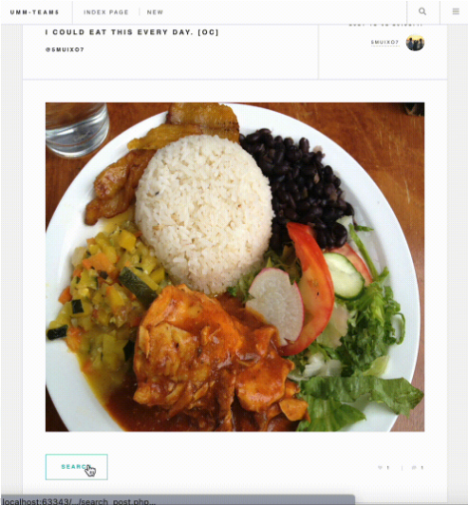
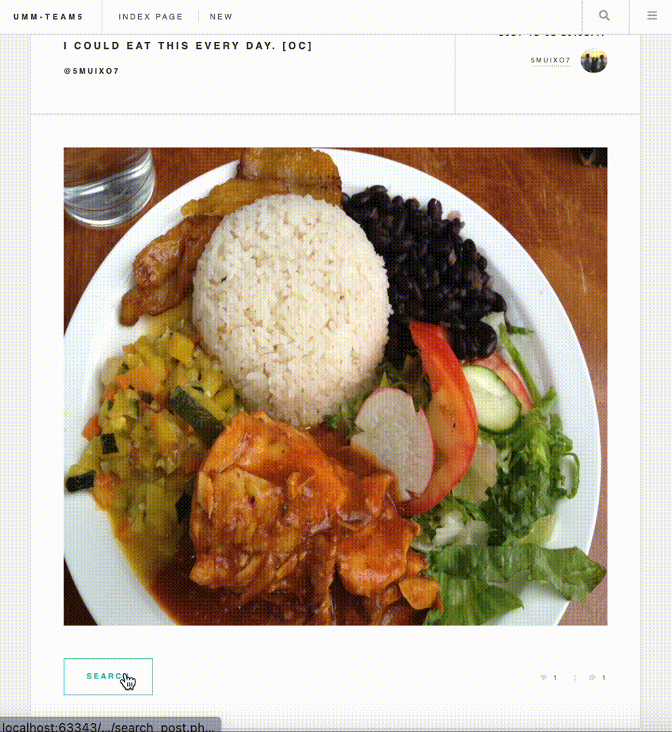

WHY?
Matching
Notes:
[GQ, Jiang]
It’s just like all social media except, there’s a search button under the post. If you click it, you’re get the search result based on both image and text. Just like a search engine, but in social media for posts.
So our project can be a project for fun. Find out who’s with you. But if the feature extraction and clustering has better performance, it can gather the information among huge amount of social media posts. It’s common that someone has a question, someone has an answer, but searching or hashtags won’t bring them together. Hopefully one day machine can do it.

Slide 5
SHOULD WE?
Target Market
Stage 0: Proof of Concept/B2B product
GTM Stage 1: Social Media, Discussion Forums, Internal Search
GTM Stage 2: Retail, Warehousing/Shipping
Accessing the first customer
As this is a B2B product, a sales team will have to have to make a case that the target business’s users would largely benefit from this technology. Therefore, showing a comparison of existing search tools alongside our product could show how much this increases user experience and retention on a given site. For user testing, we are planning an AB test, the results of which can be included in our B2B sales strategy.
Notes:
[Coco, Kyle] Why are we doing this? Like BA side, marketing, user interview, stuff like that. Feel free to change the subtitle~

Slide 6
SHOULD WE?
User Testing - Social Media Users
Need:
Search for similar content using images and text based on their own posts and interests
Expectations:
Tool is well-integrated with existing social media platforms
Intuitive user experience
Experience:
Overall positive, output was relevant to input images and text
User interface was clean and easy-to-understand
Further testing needed for business applications in the future
Notes:
[Coco, Kyle] Why are we doing this? Like BA side, marketing, user interview, stuff like that. Feel free to change the subtitle~

Slide 7

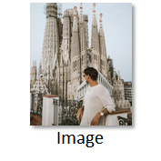


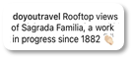

HOW?
Feature Extraction
“Landscape/Tourist”
Image Categorization API
[Json]
“Travel”
[Json]
Text Categorization API
Notes:
[Wenqi] So, as mentioned earlier, our purpose is to find the similar post and our main data source is the image and text data of the user post. So, in order to better understand the content of the post, we extract the categorization information by using APIs. Take the post as an example, our algorithm will send the image and text into Microsoft CV API and IBM NLP API, respectively. And then we will get a Json from the cloud platform. By doing processing, we can find the two most likely categories of the post.

Slide 8
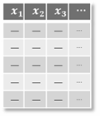
HOW?
Early Fusion: Feature Combination
“Travel”
B E R T
concat
“Landscape
/Tourist”
Notes:
[Wenqi] The next step we did is to combine these two text data and throw them into the BERT model. It is a pre-trained model that has the ability to understand the text meaning. Basically, it can convert similar text into similar vectors, which is like the Word2Vec model but it has better performance in this scenario

Slide 9
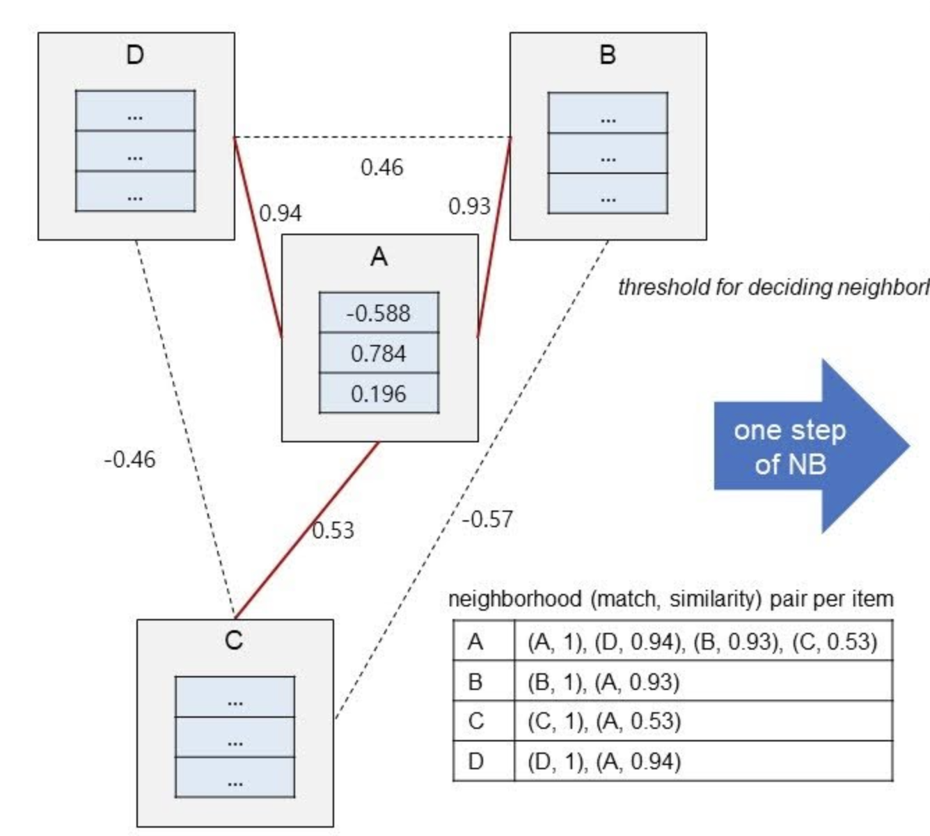

HOW?
Unsupervised Model
K-Nearest Neighbor Search
Use Euclidean distance as similarity metric
Choose the top 4 nearest neighborhoods as
recommended similar posts
Threshold for deciding neighborhood: 0.5
Acceleration: RAPIDS cuML
Notes:
[Diru] How to use unsupervised model to match a given post.

Slide 10
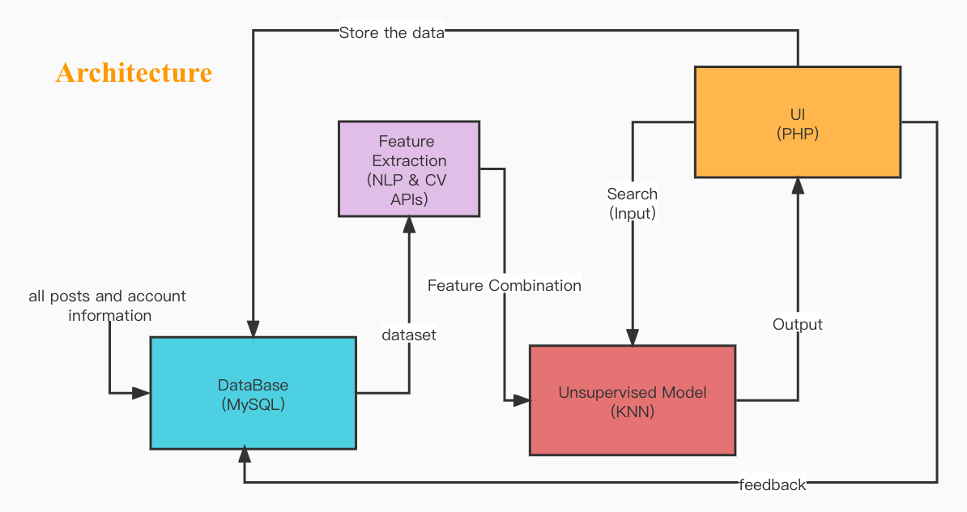
HOW?
Notes:
Then let me talk about our architecture, we uses MySQL as the database, and all posts and account information are stored in the database. These data are used as a dataset to NLP and CV APIs for feature extraction, and then they are combined and use the KNN algorithm to build a model. The user can click the search button on the ui to search and will see similar posts. Finally, the user’s new posts and feedback will be stored in the database, and we will have a larger data set, which also means we will have a better model.

Slide 11
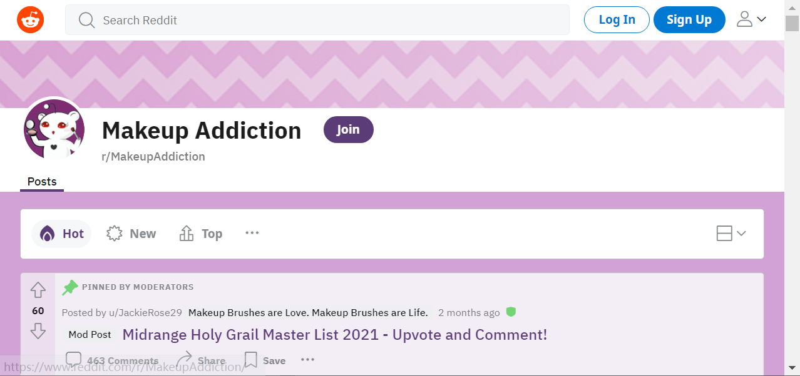
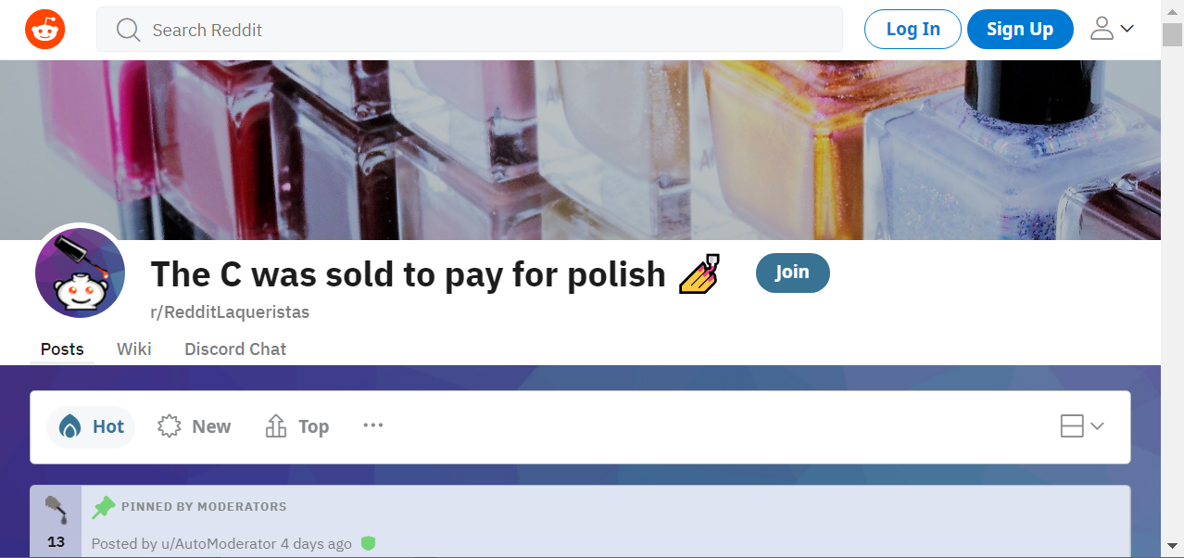
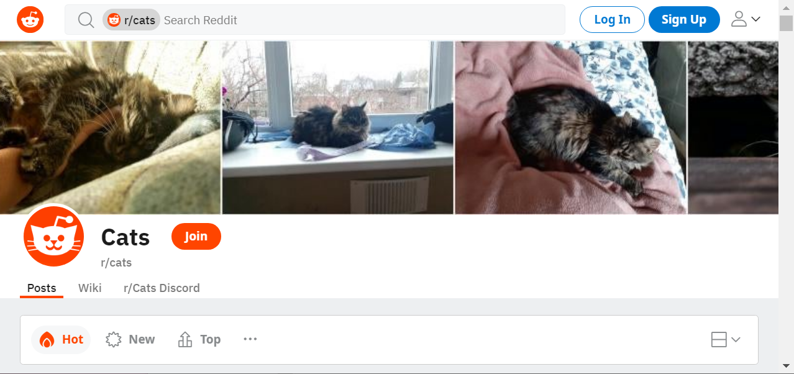
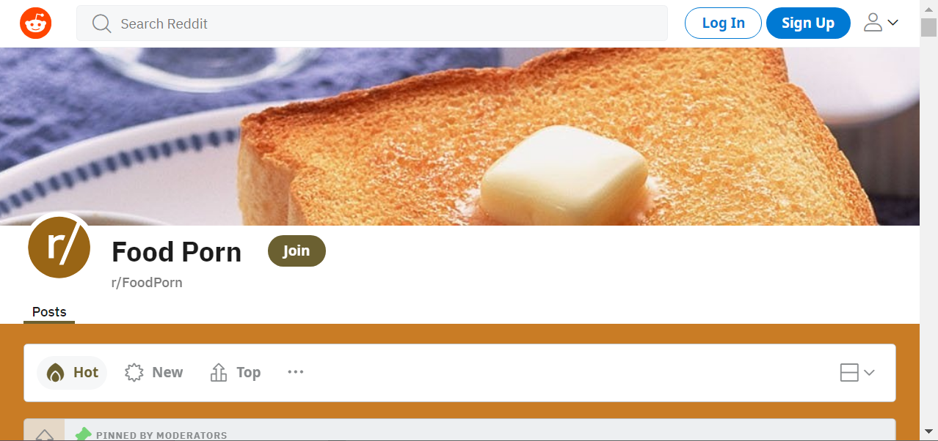

HOW?
Four topics
2k+ posts
Both images & text
over 50% reasonable
Notes:
As for our dataset, we use four topics from reddit to simulate a real social media scenario. If we considered the available labels like hashtags in data processing, we can focus our dataset on a small amount. So we only use two thousands posts, based on manually validation, over 50% is reasonable.

Slide 12
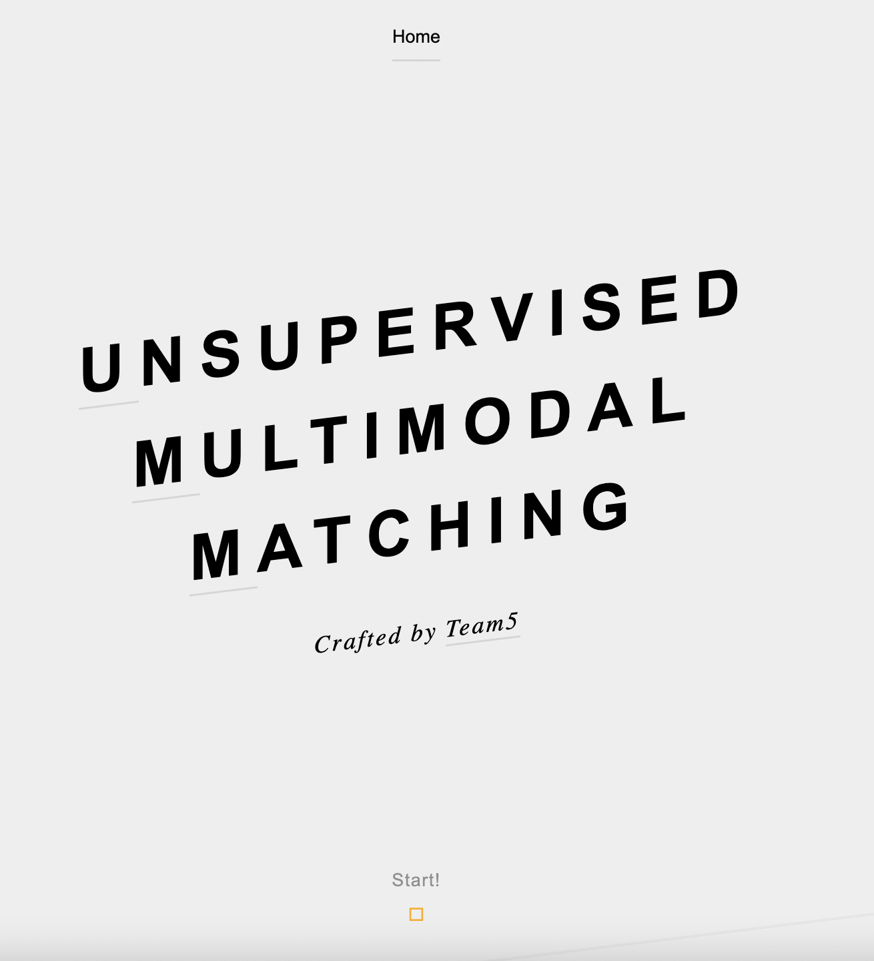
· Team 5 ·
Coco Sun
Diru Jia
GQ Gaoqu
Jiang Qu
Kyle Atkinson
Wenqi Kou
Advisor: Elaine Pang
Unsupervised
Multimodal
Matching
Notes:
That’s all about our project for now. Thanks for listening.

Slide 13
Future Work
Model Training
Product Upgrade
Supervised Learning
Available labels: Hashtags, Categories
Feature Extraction & Engineering
Subdivision of posts; Meta data
Late Fusion
Unsupervised Learning
More Metrics
Hierarchically
Database Update
Periodically update
User Feedback
CTR
Feed back to supervised model
Vague Description Search
Notes:
As a conclusion, this is a real big topic, To enhance the performance there’s many things to do. First we can make full use of available general labels in real life. Also we can treat different kinds of images separately, like Face detection, landscape detection, sentiment analysis and OCR. Make full use of metadata like location and datetime. Using late fusion instead of early fusion by BERT. Also in unsupervised model we can try

Slide 14
· Team 5 ·
Coco Sun
Diru Jia
GQ Gaoqu
Jiang Qu
Kyle Atkinson
Wenqi Kou
Advisor: Elaine Pang
Unsupervised
Multimodal
Matching
Notes:
That’s all about our project for now. Thanks for listening.

Slide 15
SHOULD WE?
Question to users
1. What is your need relate d t ____? | From the perspective of social media users, they’d like to search for similar content online based on their own posts and interests The persona of social media influencers still have yet to be tested
2. Can you talk aloud your expectation and experience while moving through the app? | Overall positive experiences with the UI Expected the platform to be more well-integrated with existing social media platforms instead of on a separate site
3. As a user, why did final output help or not help your decision- making with your problem? | Finds closely relevant images Finds people with similar hobbies Easily index inventory without having barcodes or specific product info
4. Was the effort in the app worth the return and why? | The effort was worth it because with existing posts on your platform, to it was simply with the click of a button
Easy or Difficult? | Easy
Notes:
[Coco, Kyle] Why are we doing this? Like BA side, marketing, user interview, stuff like that. Feel free to change the subtitle~

